Slide 1

Telco
Technical Presentation

Slide 2
Agenda
Mediation Readers
What are they?
Which are the readers that jBilling has?
How did we configure the one for the demo?
How do we add new Readers?
Mediation Processor
What is it for?
How does it really work?
How did we configure the one for the demo?
How do we create a new Processor?
Pricing Models
What are Pricing Models?
Which Models where used in the demo?
How do we create a new Pricing Model?
Internal Events
What are internal events?
How do we create new Events and Listeners?
Notes:
This is the agenda for todays session.
We’ll talk about 4 key concepts that we witnessed during the functional demo.
Mediation Readers: mention the questions that will be addressed.
Mediation Processors: mention the questions that will be addressed.
Pricing Models: mention the questions that will be addressed.
Internal Events: mention the questions that will be addressed.
First of all we’ll learn what the Mediation Readers are.

Slide 3

High Level Diagram
CDRs
Reader
Processor
Orders
Pricing Models
logo.png
Event
Notes:
This is meant to be a high level diagram of how the concepts seeing in the demo and in this presentation get integrated between them.
First of all we show a high level image explaining that our goal is to Have the CDRs processed by jBilling and transformed into orders.
Then we introduce the idea of the Mediation Reader and the Mediation Processor which are the actual entities in charge of transforming the CDRs into orders.
After that we show that before creating the orders the Pricing Models get executed to calculate the correct price for each item.
Finally after the Order is updated or created some events are triggered, for example the NewQuantityEvent and the NewPriceEvent.

Slide 4
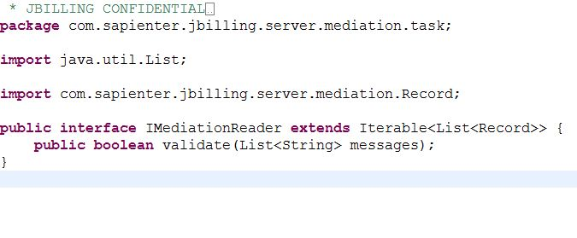
Mediation Readers
What are they?
Readers are used to read the data from different sources and translate them into an understandable object in jBilling.
This is the Record.java class that has a list of fields. So for each line/record in the source we end up having one Record.
Notes:
Read the first two points and explain them a little bit.
Then mention that we have an interface that every reader implements directly or through an abstract class. That way just by doing that and some DB queries (explained later) we can add new readers.

Slide 5
Agenda
Mediation Readers
What are they?
Which are the readers that jBilling has?
How did we configure the one for the demo?
How do we add new Readers?
Mediation Processor
What is it for?
How does it really work?
How did we configure the one for the demo?
How do we create a new Processor?
Pricing Models
What are Pricing Models?
Which Models where used in the demo?
How do we create a new Pricing Model?
Internal Events
What are internal events?
How do we create new Events and Listeners?
Notes:
Now we’ll continue to see which are the readers that are available in jBilling Out of the Box.

Slide 6
Mediation Readers
Which are the readers that jBilling has?
FixedFileReader.java
SeparatorFileReader.java
JDBCReader.java
MySQLReader.java
StatelessJDBCReader.java
Notes:
Explain a little bit about each one of the readers that jBilling has.
Fixed File Reader: Reads from a fixed file. The fields are not separated by a character, we define the start and end positions to delimiter each field.
Separator File Reader: Reads from a file where each line has the fields separated by a character. By default it’s the comma.
JDBC Reader: Reads from a database. This reader records it's progress and attempts to ensure that records are not read again on subsequent executions.
MySQL Reader: Reads from a MySQL database.
Stateless JDBC Reader: It does not change the state of the underlying database being read or persist it's progress. Unlike the the JDBCReader this reader does not update or fetch the mediation "last ID read“ preference. Every subsequent execution of this reader starts at zero.

Slide 7
Agenda
Mediation Readers
What are they?
Which are the readers that jBilling has?
How did we configure the one for the demo?
How do we add new Readers?
Mediation Processor
What is it for?
How does it really work?
How did we configure the one for the demo?
How do we create a new Processor?
Pricing Models
What are Pricing Models?
Which Models where used in the demo?
How do we create a new Pricing Model?
Internal Events
What are internal events?
How do we create new Events and Listeners?
Notes:
After that we’ll see how we configured the Reader used during the demo.

Slide 8
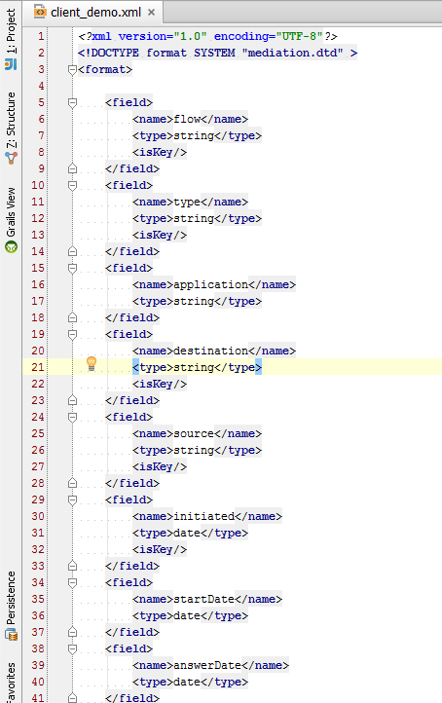
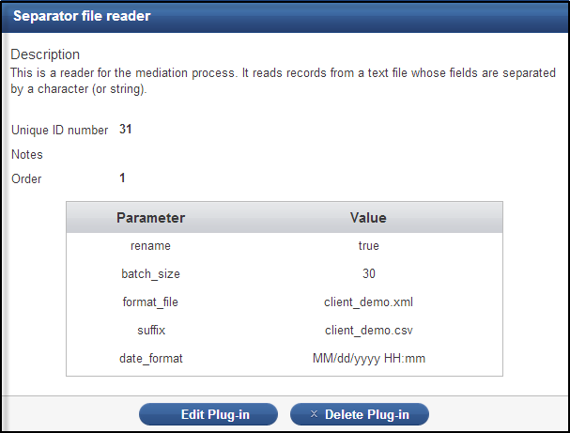
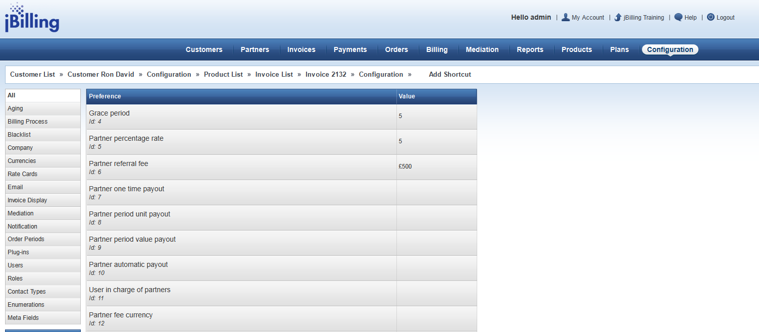
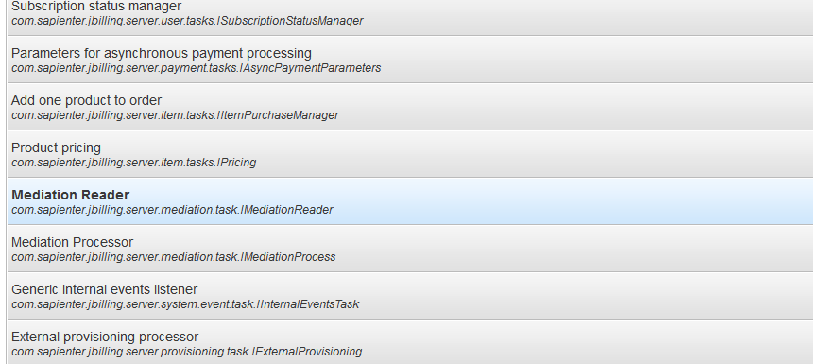
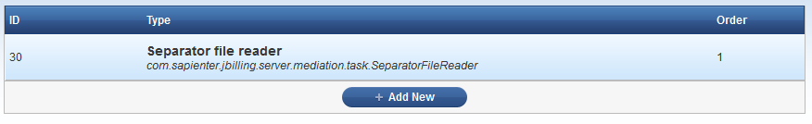
Mediation Readers
How did we configure the one for the demo?
1
3
2
Notes:
Go to the Configuration Section
Click on the Plug-ins menu on the left
Scroll down and select the Mediation Reader category (id 15)
Click the Add New button to add a new reader.
In the form fill in the following data:
Type: SeparatorFileReader
rename: true
batch_size: 30
format_file: client_demo.xml
suffix: client_demo.csv
date_format: MM/dd/yyyy HH:mm
Besides this, the reader needs a format file in order to work properly and understand the format of the file that it’s reading. The format file is in the /descriptors/mediation/ folder and it’s called client_demo.xml

Slide 9
Mediation Readers
How did we configure the one for the demo?
Code Overview
Notes:
We’ll go over the code for the reader we used for the Mediation in the demo. That would be the SeparatorFileReader.java class.
In that class we are only overriding the validate method to add some extra logic and we define the “fieldSeparator” attribute and finally we override the splitFields method to put the logic to split the line with the defined separator field.
The important logic is in the AbstractFileReader.java class. We have:
The “validate()” method does exactly that, it validates the parameters configured in the Reader plugin. @ line 107
The “getFormat()” method is the one responsible for reading the format xml file we previously defined, like the one we saw in the last slide and it translates it into an Object that jBilling understands, that is the Format class with a list of FormatField @ line 146
We have the “iterator()” method that returns a Reader which is the object that actually reads the lines from the CDR. @ line 174
We have the “Reader” inner class that does the whole magic of reading the CDR by using the configured buffer, batch_size, the format that was retrieved by the getFormat() method, and so on. An important method inside this class is the readLine() because there is where we actually read the line. @ line 185
Another important method is the “convertLineToRecord()”. This method is the one that converts a line into a Record object which has a list of “PricingField” used later from the Mediation process. This method uses the format we got before and it translates that into a Record. @ line 292
Finally we have a helper method “convertDuration()” that handles the durations. @ line 423

Slide 10
Agenda
Mediation Readers
What are they?
Which are the readers that jBilling has?
How did we configure the one for the demo?
How do we add new Readers?
Mediation Processor
What is it for?
How does it really work?
How did we configure the one for the demo?
How do we create a new Processor?
Pricing Models
What are Pricing Models?
Which Models where used in the demo?
How do we create a new Pricing Model?
Internal Events
What are internal events?
How do we create new Events and Listeners?
Notes:
Finally we’ll talk about how to create/add new Readers.

Slide 11
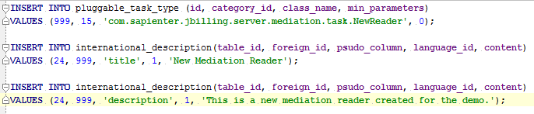
Mediation Readers
How do we add new Readers?
Notes:
First of all we need to create a new class that implemenst the IMediationReader interface. After that you will need to implement whatever is necessary to read from the source you require.
A good example of this is the AbstractReader class that implements the interface.
Then if we look at classes that extend from this abstract class we’ll see that AbstractFileReader does that.
This is a specific class with logic to read from files.
Finally we have the SeparatorFileReader class that extends from the latter with some extra logic for reading from files with fields separated by a character.
After having this class we need to run some SQL queries in order to let the system know about this new Reader and also to internationalize the title and description.
The values for the first query are:
id: It should be the next available id.
category_id: 15 is the id of the Mediation Readers category.
class_name: the name of the Java class with the full package.
min_parameters: The minimum required number of parameters. It’s used as a validation before saving it.
And the ones for the remaining two:
table_id: Id of the table to internationalize. This is found in the jbilling_table table.
foreign_id: If of the record to be internationalized.
psudo_column: It can be title or description.
language_id: Id of the language in which we are internationalizing.
content: Value for the internationalization.

Slide 12
Agenda
Mediation Readers
What are they?
Which are the readers that jBilling has?
How did we configure the one for the demo?
How do we add new Readers?
Mediation Processor
What is it for?
How does it really work?
How did we configure the one for the demo?
How do we create a new Processor?
Pricing Models
What are Pricing Models?
Which Models where used in the demo?
How do we create a new Pricing Model?
Internal Events
What are internal events?
How do we create new Events and Listeners?
Notes:
Now we are going to talk about Mediation Processors, another important component of the Mediation Process.

Slide 13
Mediation Processor
What is it for?
The Mediation Processor is where all the logic is. The Reader calls the processor for every record that was read and the processor is the one that ends up creating or updating an order in the system.
It turns out to be one really important piece of the whole process.
Notes:
Just read the notes and add some comments if needed.

Slide 14
Agenda
Mediation Readers
What are they?
Which are the readers that jBilling has?
How did we configure the one for the demo?
How do we add new Readers?
Mediation Processor
What is it for?
How does it really work?
How did we configure the one for the demo?
How do we create a new Processor?
Pricing Models
What are Pricing Models?
Which Models where used in the demo?
How do we create a new Pricing Model?
Internal Events
What are internal events?
How do we create new Events and Listeners?
Notes:
How does a Mediation Processor really work? We are going to answer that question now.

Slide 15

Mediation Processor
How does it really work?
Resolve User
Resolve Currency & Date
Resolve Current Order
Mediation
Task
1
(Trigger)
Calls Detail Record (CDR)
1 | sdd | 34 | 3edrfg | 56
2 | sjws | 26 | edrfgt | 43
.. | wer | 3 | sdfg | 34
1m | cds | 48 | dsg | 34
Mediation
Process
Mediation
Reader
Line Creation
Resolve Price (external)
Resolve Item
2
3
Orders
1 | sdd | 2s | s
2 | siws | s | s
3 | wer | s | s
Item Management
(external)
Notes:
These are the steps that happen during the process. And all this happens inside the Processor, that’s why it plays a really important part in our Mediation.
Explain each step and match it agains the demo Processor we have which is DemoMediationProcessor.java
The two steps that are external won’t have a match but the other 5 will.
Matches:
Resolve User: resolveUserCurrencyAndDate() -> resolveUser()
Resolve Currenty & Date: resolveUserCurrencyAndDate() -> resolveDate()
Resolver Current Order: isActionable()
Line Creation: doEventAction()
Resolve Item: doEventAction()
Then we’ll show a summary of thow the whole process works.
The Mediation Task is fired.
The Process is triggered.
The Reader reads the records from the CDR.
The records are translated into orders in our Processor.

Slide 16
Agenda
Mediation Readers
What are they?
Which are the readers that jBilling has?
How did we configure the one for the demo?
How do we add new Readers?
Mediation Processor
What is it for?
How does it really work?
How did we configure the one for the demo?
How do we create a new Processor?
Pricing Models
What are Pricing Models?
Which Models where used in the demo?
How do we create a new Pricing Model?
Internal Events
What are internal events?
How do we create new Events and Listeners?
Notes:
How does a Mediation Processor really work? We are going to answer that question now.

Slide 17
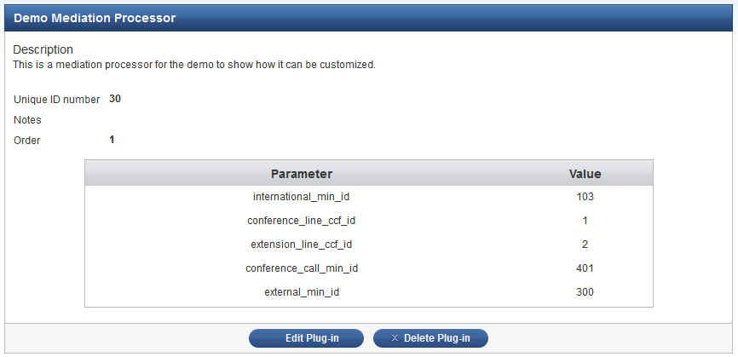
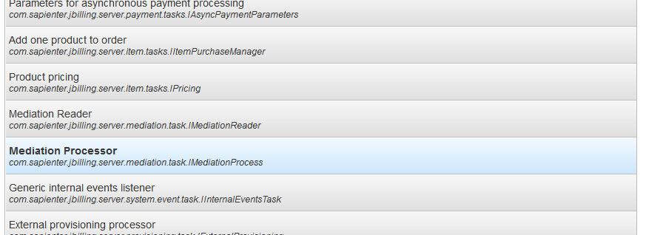

Mediation Processor
How did we configure the one for the demo?
1
3
2
Notes:
Go to the Configuration Menu
Then click on the Plug-ins menu on the left
You will see the list of Plug-in categories
Select the one called Mediation Processor (id=16)
Click the Add New button
In the form fill in the following information:
Type: DemoMediationProcessor
Order: 1
conference_line_ccf_id: 1
extension_line_ccf_id: 2
international_min_id: 103
external_min_id: 300
conference_call_min_id: 401
Save the plugin

Slide 18
Mediation Processor
How did we configure the one for the demo?
Code Overview
Notes:
We’ll go over the code of the processor used in the demo. That is the DemoMediationProcessor.java class.
Key things to mention are:
The method resolveUserCurrencyAndDate(): Is the implementation for the interface and we extracted the code into two private methods to make the code clearer.
So we have the resolveUser() method that resolves a user from the record read by the reader. The logic here is that we search for a Customer depending on a meta field value:
UserDTO user = findUserByMetaField(getConferenceLineCCFId(), userNumber); @ line 123
And user = findUserByMetaField(getExtensionLineCCFId(), userNumber); @ line 132
The value of the meta field is retrieved from the record, and which field depends on if the call is incoming or outgoing:
if ("in".equals(flow)) @ line 110
if ("out".equals(flow)) @ line 115
We also have the resolveDate() method that gets the date from a field in the record. The field is called “initiated”.
The next step is to get the order to be updated or created. That would be the “isActionable()” method. This method can also be used to do some extra validations to stop the mediation of the current record if needed:
if ("local".equals(type.getStrValue())) {…} @ line 170 – If the call is local we skip it.
if (duration.getIntValue().equals(0)) {…} @ line 178 – If the duration of the call is zero we also skip it.
We get the order @ line 189.
Finally the last important step is to resolve the record to an item and set the quantity. That’s the doEventAction() method.
This is how we add a new line:
result.getLines().add(newLine(getParameter(PARAM_CONFERENCE_CALL_MIN_ID.getName(), 0), minutes)); @ line 225 – Set the Item id.
result.setDescription("Conference call in " + source); @ line 226 – Add the description for the line.

Slide 19
Agenda
Mediation Readers
What are they?
Which are the readers that jBilling has?
How did we configure the one for the demo?
How do we add new Readers?
Mediation Processor
What is it for?
How does it really work?
How did we configure the one for the demo?
How do we create a new Processor?
Pricing Models
What are Pricing Models?
Which Models where used in the demo?
How do we create a new Pricing Model?
Internal Events
What are internal events?
How do we create new Events and Listeners?
Notes:
Now we’ll see how to create a new Mediation Processor to jBilling.

Slide 20
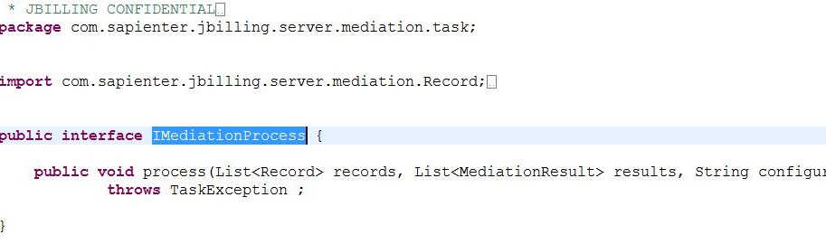
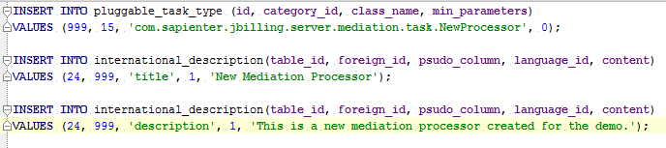
Mediation Processor
How do we create a new Processor?
Notes:
All you have to do is create a class that implements the IMediationProcess interface. Altough, we do have an abstract class in jBilling that adds some extra behavior to the Processor and makes it easier to implement one, that’s the AbstractResolverMediationTask class.
In fact you can see in our DemoMediationProcessor that we extend from it.
After having this implementation we need to execute some queries to let the system know about this new plugin and also internationalize the name and description.
The values for the first query are:
id: It should be the next available id.
category_id: 15 is the id of the Mediation Readers category.
class_name: the name of the Java class with the full package.
min_parameters: The minimum required number of parameters. It’s used as a validation before saving it.
And the ones for the remaining two:
table_id: Id of the table to internationalize. This is found in the jbilling_table table.
foreign_id: If of the record to be internationalized.
psudo_column: It can be title or description.
language_id: Id of the language in which we are internationalizing.
content: Value for the internationalization.

Slide 21
Agenda
Mediation Readers
What are they?
Which are the readers that jBilling has?
How did we configure the one for the demo?
How do we add new Readers?
Mediation Processor
What is it for?
How does it really work?
How did we configure the one for the demo?
How do we create a new Processor?
Pricing Models
What are Pricing Models?
Which Models where used in the demo?
How do we create a new Pricing Model?
Internal Events
What are internal events?
How do we create new Events and Listeners?
Notes:
How does a Mediation Processor really work? We are going to answer that question now.

Slide 22
Pricing Models
What are Pricing Models?
A price model represents how a price is calculated
A model tells the system what pricing calculation to use.
A model can query past usage when calculating a price.
There are several pricing calculations, or strategies that can be selected. A price is calculated using a selected strategy. Past usage is queried by the system if the strategy requires it.
Strategy
Requires Usage?
Get Past Usage
Calculate a price
Metered
Graduated
Flat
Rate Card
And more…
Notes:
Read the bullet points. The most important thing here is that Pricing Models is where the logic on how to calculate the price resides.
We have many already built-in models in jBilling.

Slide 23
Agenda
Mediation Readers
What are they?
Which are the readers that jBilling has?
How did we configure the one for the demo?
How do we add new Readers?
Mediation Processor
What is it for?
How does it really work?
How did we configure the one for the demo?
How do we create a new Processor?
Pricing Models
What are Pricing Models?
Which Models where used in the demo?
How do we create a new Pricing Model?
Internal Events
What are internal events?
How do we create new Events and Listeners?
Notes:
Let’s see which Models were used during the demo.

Slide 24
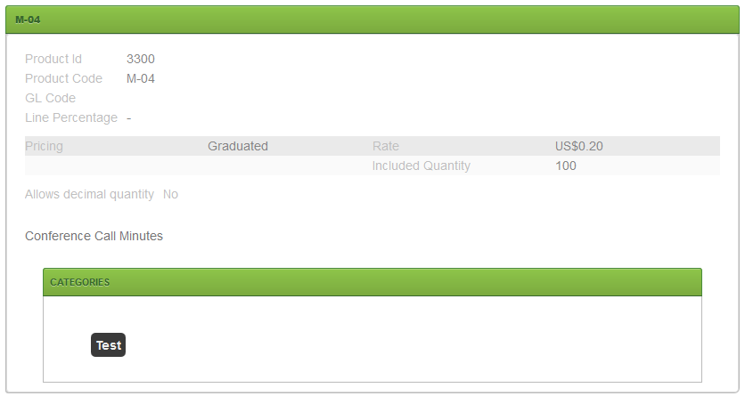
Pricing Models
Which Models where used in the demo?
Graduated
The customer will receive a set amount or an included quantity of that particular product for free.
After that set number runs out, they are charged for that product.
Class: GraduatedPricingStrategy.java
Notes:
The Pricing Model we used in the demo is the one called Graduated.
Explain the bullet points.
Show the image of how the product was configured to see the Included quantity and rate.

Slide 25
Agenda
Mediation Readers
What are they?
Which are the readers that jBilling has?
How did we configure the one for the demo?
How do we add new Readers?
Mediation Processor
What is it for?
How does it really work?
How did we configure the one for the demo?
How do we create a new Processor?
Pricing Models
What are Pricing Models?
Which Models where used in the demo?
How do we create a new Pricing Model?
Internal Events
What are internal events?
How do we create new Events and Listeners?
Notes:
Finally let’s see how we create or add new Pricing Strategies to jBilling.

Slide 26
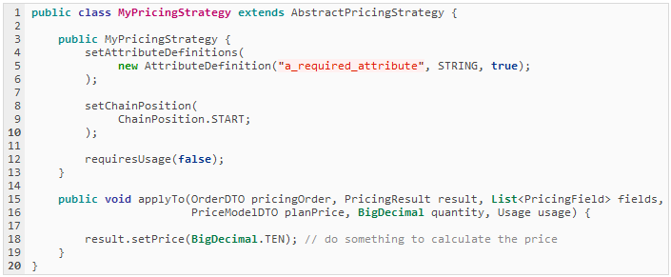
Pricing Models
How do we create a new Pricing Model?
Step 1: Add a strategy class
Notes:
The first step is to create a new Pricing Strategy.
A new strategy should extend from the AbstractPricingStrategy class,
The most important part is to implement the applyTo() method which should calculate the price and set it in the PricingResult object.

Slide 27
Pricing Models
How do we create a new Pricing Model?
Step 1: Add a strategy class
Attribute Definition
Your price strategy can define required attributes as "attribute definitions". The attribute definition specifies the name of the attribute, the data-type and if it's required.
Chain Position
The chain position defines where this particular price strategy can appear in a chain. Some price strategies (such as percentage) should only be used at the end of a chain, others only at the start.
Requires Usage
If set to true, the past "Usage" for the product being purchased will be counted and passed into the applyTo() method.
Notes:
These are the things we can define in our Strategy class.
First of all the attributes that will be available to configure. We can define the name, the type and even if it’s required or not.
Then we can set the chain position for this strategy. We can tell the system the positions in which this model can be added.
Finally, we can tell the system if the model requires past usage data. If not, then we avoid doing a lot of DB queries to retrieve all that information.

Slide 28
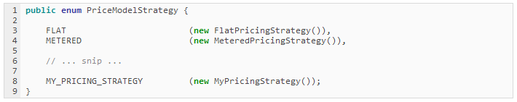
Pricing Models
How do we create a new Pricing Model?
Step 2: Update the strategy enum
Add a new entry to the PriceModelStrategy enum, this gives your strategy a name and makes it usable in a Price Model
Notes:
The next step is to add a new entry to the PriceModelStrategy enum. This is a way to tell the system which models are available.

Slide 29
Pricing Models
How do we create a new Pricing Model?
Step 3: UI Template
Templates live in grails-app/view/priceModel/strategy/
The enum name is converted to ‘camelCase’ and used for determining the name of the UI template
PriceModelStrategy.METERED
PriceModelStrategy.MY_PRICING_STRATEGY
_metered.gsp
_myPricingStrategy.gsp
Notes:
One of the last steps is to create a template gsp page to show in the UI.

Slide 30
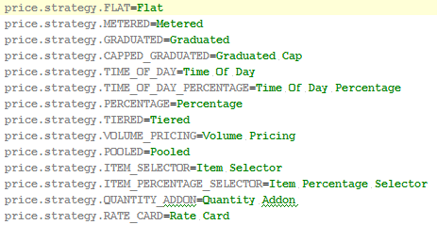
Pricing Models
How do we create a new Pricing Model?
Step 4: i18n
In the messages.properties file look for the line: price.strategy.
There add a new entry following this pattern: price.strategy.MY_PRICING_STRATEGY
So it’s the same name you used in the enum.
Notes:
Finally we need to internationalize our new Pricing Model.

Slide 31
Pricing Models
How do we create a new Pricing Model?
Show Example
Notes:
We are going to show a quick example to demonstrate how easy it is to add a new Pricing Strategy to jBilling.
For this example we are going to add a new Pricing Model that increases the price of the product depending on the country of the Customer.. We’ll assume that the complexity of the code is something extra.
Copy the file CountryPricingStrategy.java to the following path: src/java/com/sapienter/jbilling/server/pricing/strategy/
Copy the file _country.gsp to the following path: grails-app/views/priceModel/strategy/
Modify the PriceModelStrategy.java enum to add our recently created model
This is the piece of code you need to add just bellow the last entry:
/** Pricing strategy that increases the price depending on the country.*/
COUNTRY (new CountryPricingStrategy());
Remember to replace the last ; with a , and import the CountryPricingStrategy.java class
Modify the messages.properties file and add this line: price.strategy.COUNTRY=Country right after the last line which should be the RATE_CARD.
Run a full clean/compile and start the application again.
Now you should be able to use the new pricing model without any problem.
Create a new product with the information like in the image price_model_example.png. That configuration means that the rate of the product is 10 dollars and the percentage to be applied if the country is US is 5%, if the country is CA is 50% and by default if the country wasn’t listed here we use a 10%.
Try creating an order for a customer and you will see that the rate gets incremented according to the configured percentage. Edit the customer to change the country from CA to US and you will see a change in the price when creating an order. Finally edit the customer again and select a country that’s not CA or US and when creating the order it should use the default percentage.

Slide 32
Agenda
Mediation Readers
What are they?
Which are the readers that jBilling has?
How did we configure the one for the demo?
How do we add new Readers?
Mediation Processor
What is it for?
How does it really work?
How did we configure the one for the demo?
How do we create a new Processor?
Pricing Models
What are Pricing Models?
Which Models where used in the demo?
How do we create a new Pricing Model?
Internal Events
What are internal events?
How do we create new Events and Listeners?
Notes:
In our last topic we’ll be talking about Internal Events in jBilling.

Slide 33
Internal Events
What are internal events?
Internal event plug-ins “listen” for a specific event that is triggered and perform an action when it does (listener pattern).
Events extend/implement the event interface.
An Event encapsulates all the information that is needed by the listener to process.
EVENT
LISTENER
ACTION
Notes:
Internal events follow the listener pattern.
We have an Event that is triggered when something specific happens and there’s a listener class that is waiting for one or more events to be fired. At that point it catches the event and process the information contained within to perform some predefined action.

Slide 34
Agenda
Mediation Readers
What are they?
Which are the readers that jBilling has?
How did we configure the one for the demo?
How do we add new Readers?
Mediation Processor
What is it for?
How does it really work?
How did we configure the one for the demo?
How do we create a new Processor?
Pricing Models
What are Pricing Models?
Which Models where used in the demo?
How do we create a new Pricing Model?
Internal Events
What are internal events?
How do we create new Events and Listeners?
Notes:
Finally as our last section of the training let’s see how to create new Events and Listeners.

Slide 35
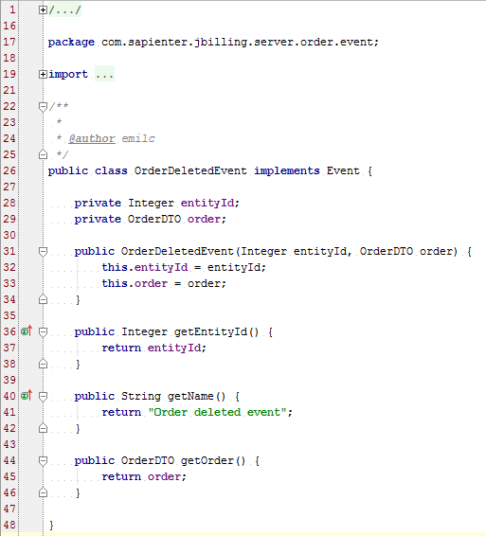
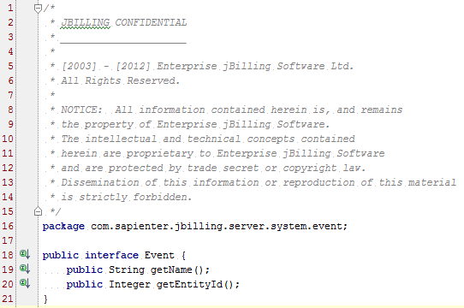
Internal Events
How do we create new Events and Listeners?
Step 1: Create the Event
Notes:
The first step is to create the class that will represent the Event.
It has to implement the Event interface.
It also has to contain all the extra information that will be needed by the listener.
In our example it also has an OrderDTO object because this event is triggered when an Order is deleted, so we’ll need the order’s information in the listener to perform some specific action.
As an example you can show the code for the OrderDeletedEvent.java Event which is in: src\java\com\sapienter\jbilling\server\order\event\OrderDeletedEvent.java

Slide 36
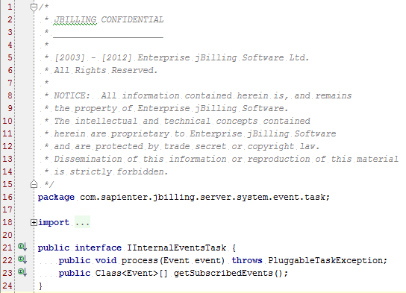
Internal Events
How do we create new Events and Listeners?
Step 2: Create the Listener
Notes:
The next step is to create the listener itself.
The listener class has to extend from the PluggableTask class because it’s a plugin and it has to implement the IIternalEventsTask interface.
As an example you can show the code for the DynamicBalanceManagerTask.java Listener which is in: src\java\com\sapienter\jbilling\server\user\balance\DynamicBalanceManagerTask.java

Slide 37
Internal Events
How do we create new Events and Listeners?
Step 2: Create the Listener - Architecture
Event A
Event B
Listener 1
Listener 2
Notes:
The architecture of an Event-Listener Pattern is that you can have:
More than one Event
More than one Listener
One event can be listened by one Listener
One event can be listened by more than one Listener

Slide 38
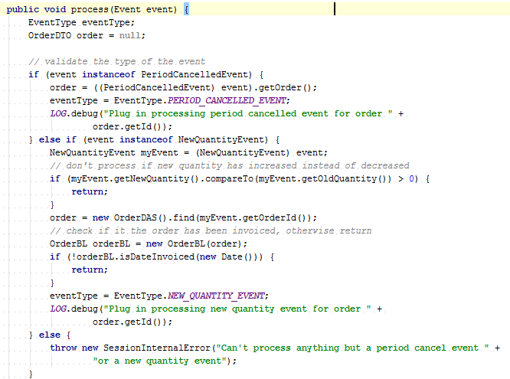
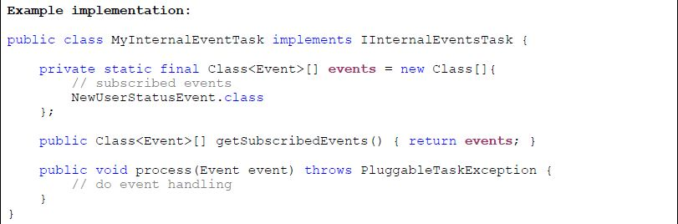
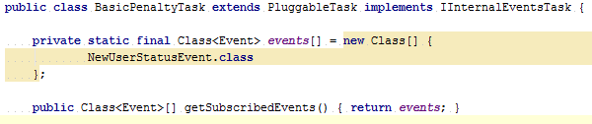
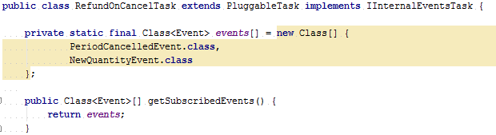
Internal Events
How do we create new Events and Listeners?
Step 2: Create the Listener - Implementation
Notes:
By implementing the IIternalEventsTask interface you have to implement 3 methods:
You have to define the events to which the listener class listens to.
You have to define a method that returns those events.
You have to define the method that will process the event and perform an action.
As an example we have the BasicPenaltyTask listener that listens only to one event.
Or we also have the RefundOnCancelTask listener that listens to two events.
Finally we show an example of how we handle a listener that listenes to more than one event.

Slide 39
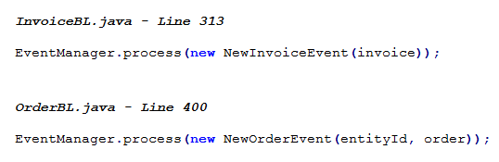
Internal Events
How do we create new Events and Listeners?
Step 3: Trigger the Event
Notes:
The next step is to trigger the Event wherever we need to.
It’s a really simple thing to do, just one line of code.
Here we have two examples of existing triggered events. (The line numbers may have changed due to new development)

Slide 40
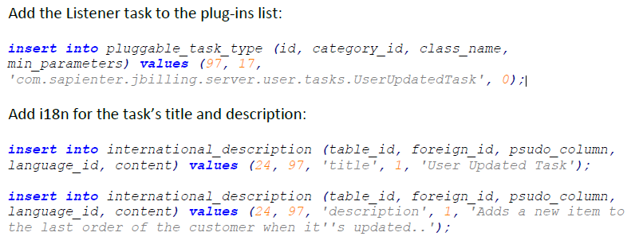
Internal Events
How do we create new Events and Listeners?
Step 4: DQ Queries
Notes:
Now we need to internationalize the listener plugin and also add it to the DB so that the system knows about its existence.

Slide 41

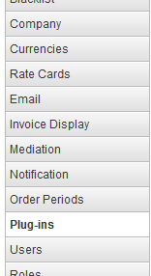
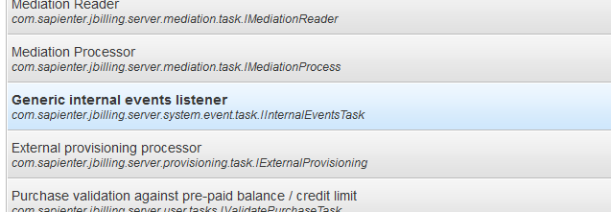
Internal Events
How do we create new Events and Listeners?
1
Step 5: Configure the Listener plugin class
3
2
Notes:
The following step is to configure the listener plugin, if not the system won’t have any class listening to our event.
Go to the configuration section.
Click on the Plug-ins menu on the left.
Scroll down to the “Generic internal events listener” category.
Click the Add New button.
Configure the listener you just created or any other that already exists.

Slide 42
Internal Events
How do we create new Events and Listeners?
Show Example
Notes:
We are going to show a quick example to demonstrate how easy it is to add Internal Events and Listeners in jBilling.
For this example we are going to create 1 (one) new Event that is triggered when the Customer is created. When the listener class catches the event we just add a new note to it to state that it was just created.. Note that this is just a simple example to show the flexibility of the system. At this point you can add any logic you may need, modify something in the system, notify a user, connect with an external system, etc.
Copy the UserCreatedEvent.java class into the following path: src/java/com/sapienter/jbilling/server/user/event/UserCreatedEvent.java
Copy the UserUpdatedTask.java class into the following path: src/java/com/sapienter/jbilling/server/user/tasks/UserUpdatedTask.java
Now we need to run a few queries to let the system know about this new listener class:
Add the Listener task to the plug-ins list:
insert into pluggable_task_type (id, category_id, class_name, min_parameters) values (97, 17, 'com.sapienter.jbilling.server.user.tasks.UserUpdatedTask', 0);
Add i18n for the task’s title and description:
insert into international_description (table_id, foreign_id, psudo_column, language_id, content) values (24, 97, 'title', 1, 'User Updated Task');
insert into international_description (table_id, foreign_id, psudo_column, language_id, content) values (24, 97, 'description', 1, 'Adds a new item to the last order of the customer when it''s updated.');
We need to trigger the Events:
At the public Integer createUser(UserWS newUser) throws SessionInternalError {…} method in the WebServicesSessionSpringBean.java API implementation class, right before the return statement add the following line:
EventManager.process(new UserCreatedEvent(userId, entityId, getCallerId()));
Remember to import the event classes and the EventManager also!
Run a full clean/compile and start the application again.
Go to the Configuration menu
Click on the Plug-ins menu on the left
Scroll down to the “Generic internal events listener” category.
Click the Add New button to add a new listener class, and select the UserUpdatedTask from the drop-down menu.
Now try creating a new user and you should see a new note was added to it that it wasn’t added when we created it.

